Slide 1
Comfy UI - Node Place Like Home Crafting AI Art with Comfy UI
By Matthew Zamora for Bethesda Data Science

Slide 2

Launching Comfy UI 1. Open Anaconda and cd to project 2. Launch python venv 3. python main.py See: https://github.com/MoCoMakers/Comfy-UI-workflows

Slide 3
Foundational Concepts
Be aware that MOST models train images at 512x512 resolutions. This means that image generation is fastest/best at that same resolution. Of course you can create images larger than that, but it might invite the introduction of strange artifacts – e.g. you ask for one person but in a wide-screen layout you end up getting two people
I tend to use: 512x512, 512x720, and 720x512
Consider if a landscape or portrait ratio would better prompt your image. A single person may better generate with portrait orientation, but a mountain landscape may generate better widescreen. Consider what source material images may have been.
It’s generally better to generate a smaller de novo image, and then use an Upscaler to increase the size to 4K resolution
We will cover the following terms applied in practice:
Checkpoints, pickle/safetensors, VAE, LoRA, VAE, embeddings

Slide 4
Informal Definitions (see literature for full definition)
Checkpoints – Modified versions of StableDiffusion trained on a subsets of image that generally select for quality, or aesthetic over broad coverage of keywords/concepts
Pickle/safetensors – Formats for sharing files. Safetensors is more modern than Pickles and is generally recommended by HuggingFace (pickles can harbor malware)
VAE – Work with encoding/decoding of images from in latent space. These are a type of model, some specialize in a function.
LoRA – Low-Rank Adaptation (for LLM) – These are used to express a ‘style’ of art. For example show a picture of the Eiffel Tower in the ‘style’ of Picasso’s Starry Night. A LoRA is a small file that can be trained with as little as 15-30 images.
Embeddings – in the context of ComfyUI – generally embeddings are models that that tweak the generative scoring of prompts. Most embeddings are used in the negative prompt for example putting (negative_hand) in the Negative prompt may fix ugly hand artifacts

Slide 5
Ecosystem Players
HuggingFace – Like GitHub but for models
Download and share all types of models. Sometimes models have a web interface for trying out a model.
CivitAI - https://civitai.com/
Use this to download the main StableDiffusion checkpoints, as well as LoRAs and reference projects
ComfyUI and third-party nodes
Most projects are shared via GitHub, and need to be discovered organically

Slide 6
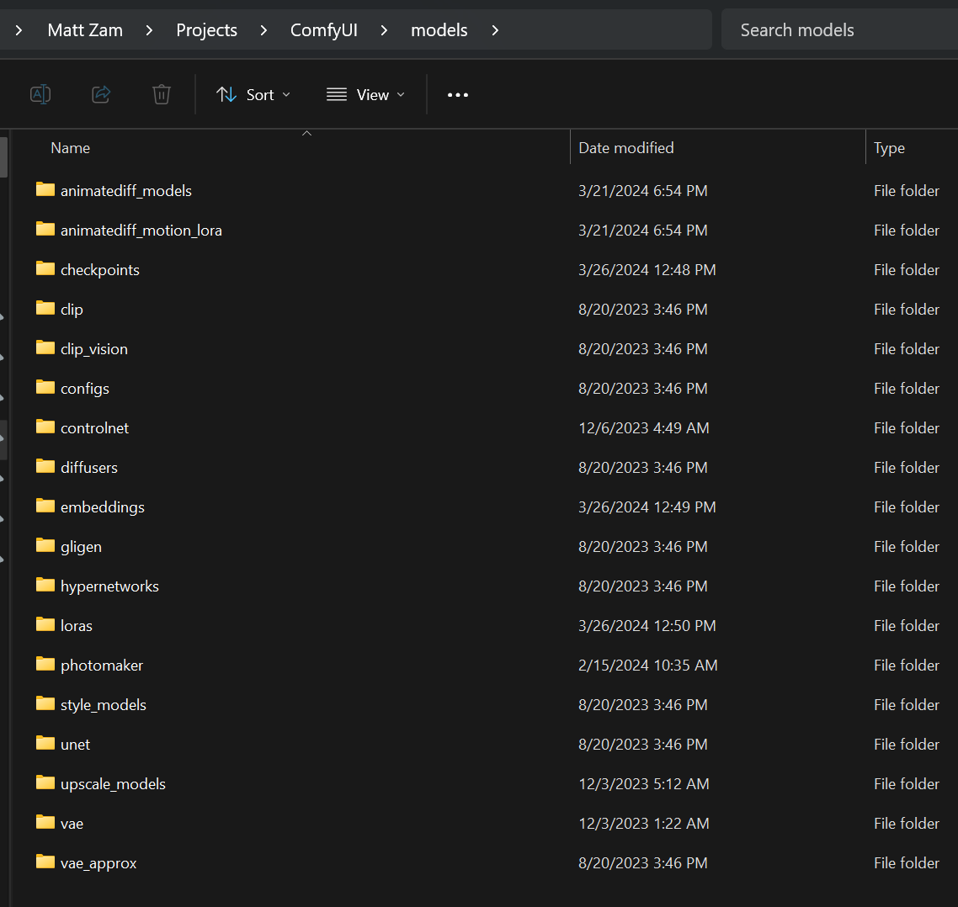
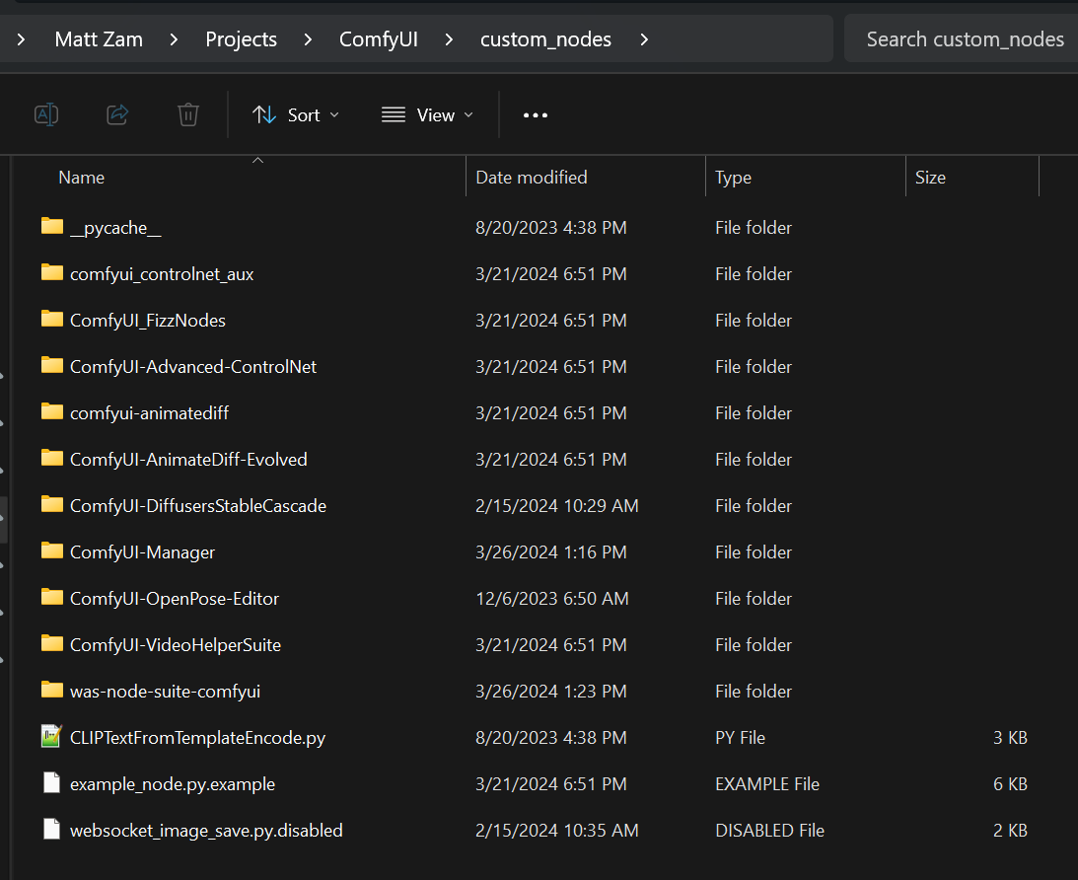
The Project Structure

Slide 7
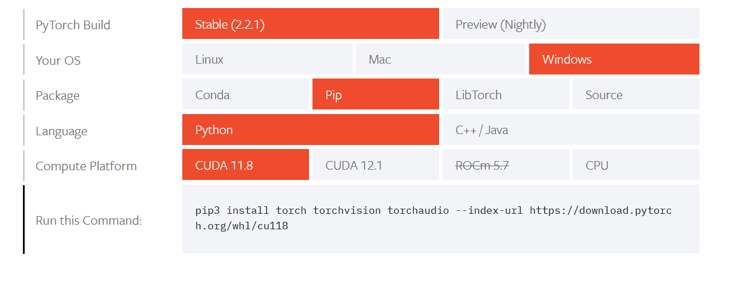
Gotchas - Installation
Installation of the core dependencies of ComfyUI is VERY CHALLENGING - Expect to spend 2-3+ hours just on first-time installation and troubleshooting
Install CUDA Toolkit - https://developer.nvidia.com/cuda-11-8-0-download-archive
Refer to and install the dependencies from the better documented project - https://github.com/bmaltais/kohya_ss
Windows Manual Install of ComfyUI:
git clone https://github.com/comfyanonymous/ComfyUI
You must use git, because this is how you update ComfyUI, and nodes will break every 2 months or so unless you keep things updated
Install Anaconda – https://www.anaconda.com/download - Don’t even try to run this in your primary OS python – it’s too painful
Create a Python venv in ComfyUI and activate it!
Install NVIDIA dependencies (inside Anaconda)
Install PyTorch with CUDA enabled. Keep track of which version of CUDA you are using: https://pytorch.org/get-started/locally/ -
Our Demos All Use CUDA 11.8
Run: pip install –r requirements.txt

Slide 8
Gotchas - Performance
You NEED a modern GPU to run these models. Your GPU needs at least 8GBs of memory! More is more better – many models can’t even be opened unless you have 16-32GBs, some need 64GB (these usually are not the popular models). GPU memory is one of the largest bottlenecks, if it’s too small you can’t even open the model.
You need CUDA on an NVIDIA processor. Supposedly AMD graphics cards may work (Linux Only) but I can’t confirm that.
Set your graphics, power and CPU performance to MAX. Even with this my system (Windows 11) won’t even run pipelines full speed unless I’m plugged in (no battery power)
Pick and be aware of which CUDA version you use. Research all projects you plan to use because they may require a specific version of the CUDA toolkit – and you can’t run more than one version of this at once. Our demos use CUDA Toolkit 11.8

Slide 9
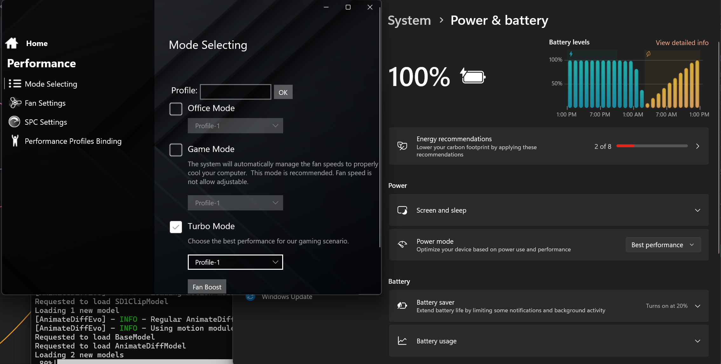

Slide 10
Gotchas Maintenance
Download ComfyUI (and generally speaking, other packages) from git – don’t do a direct download or .zip file
Git will be how you want to update your ComfyUI version
You need to update ComfyUI every 2 months or so or things (new node types) start to break. Don’t download it manually because you need to preserve files you placed in various subdirectories.
Keep all modules and Comfy UI updated. Use the “ComfyUI-Manager” module to update and install all other modules

Slide 11
You Need ComfyUI-Manger for Sanity
ComfyUI is an Ad Hoc Open Source Platform – third party modules are created all the time and are generally only 1-2 months behind cutting edge popular tech announcements.
You can download ComfyUI workflows online as .json files. But they often reference Node types that are “Missing” and will throw big red errors when you queue the run. You need to learn to troubleshoot these. To make things easier use this module for a GUI addon that let’s you find “Missing” plugins.
Follow the install directions of https://github.com/ltdrdata/ComfyUI-Manager
This is the only time you need ‘manually’ place a node package in ComfyUI/custom_nodes
After this the Manager will do all that for you. In lieu of this you need to put new node types in this directory, generally by cloning from GitHub
You may also find missing models, checkpoints, VAE files. Copy down the names and see if you can find them on HuggingFace, CivitAI or Google.

Slide 12
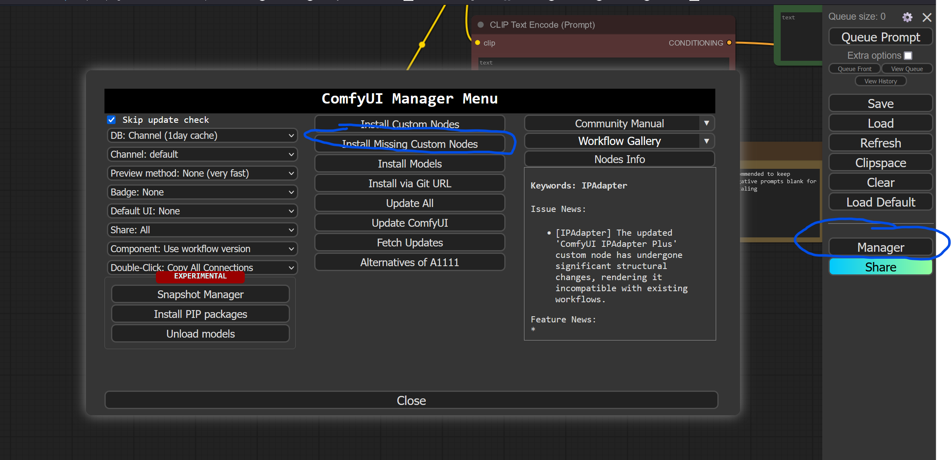
The “Manger” button becomes available with ComfyUI-Manager

Slide 13
Troubleshooting a Missing VAE
See Missing VAE example https://github.com/MoCoMakers/Comfy-UI-workflows/tree/master/brokenWorkFlowDemo

Slide 14
Demo Sequence
Basic Image Generation
Using a LoRA
Chaining a LoRA
Masking an Image
Masking an Image with Depth Maps
Image Upscaling (1 and 2)
Text to Video
Text to Video With LoRA
Text to Video with Upscaling (1 and 2) https://github.com/MoCoMakers/Comfy-UI-workflows/tree/master/brokenWorkFlowDemo

Slide 15
Training a LoRA
Follow the install directions from https://github.com/bmaltais/kohya_ss You will need:
CUDA 11.8 toolkit
Visual Studio redistributable
Anaconda, configured for python 3.10.11
Remember to create a python Virtual Environment (venv) and run setup.bat from inside there
Launch the app using: python kohya_gui.py (from inside Anaconda)

Slide 16
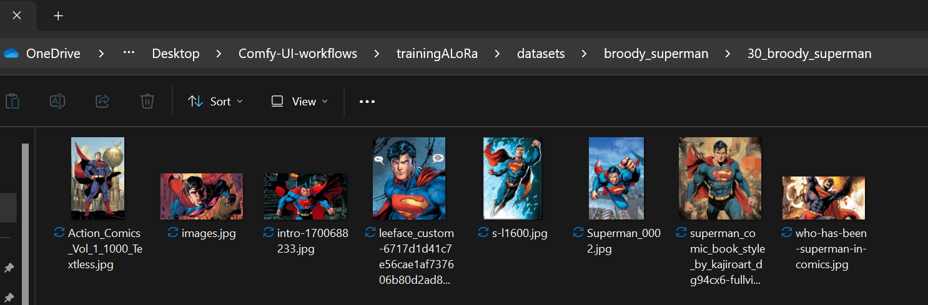
Create your dataset folder
Clone our repo. Inside the datasets folder, copy the reference “dataset-name” directory, and give it a new name.
Folder structure:
datasets -- dataset-name ---- 30_keyword_here ---- 30_other_keyword
-- totally-separate-dataset
… Where “30” represents the number of training repeats. And “keyword_here” is the magic token used in prompts when applying your LoRA. See: https://civitai.com/articles/506/kohyass-webui-dataset-preparation-beginners-guide
Ideally have 15-30 images that represent a ‘style’ you want to recreate. Size doesn’t matter but go for quality images that capture your effect/style/aesthetic/concept.

Slide 17
Training a LoRA
Overview of steps:
Run kohya_gui.py in Anaconda (with activated venv)
Go to LoRA tab then -> Training subtab
Select “Image Folder” for input dataset. This should be the directory above: 30_Lora_keyword_here
The subdirectory should have all the .jpg files
Using your model: Move the output to the loras folder in ComfyUI. Create a LoadLoRa node and pass it to in front of your prompts. The model should go from Checkpoint->LoadLora->VAE Decoder
Use your by adding your keywords to the prompt, and modifying the strength of the LoadLora node

Slide 18
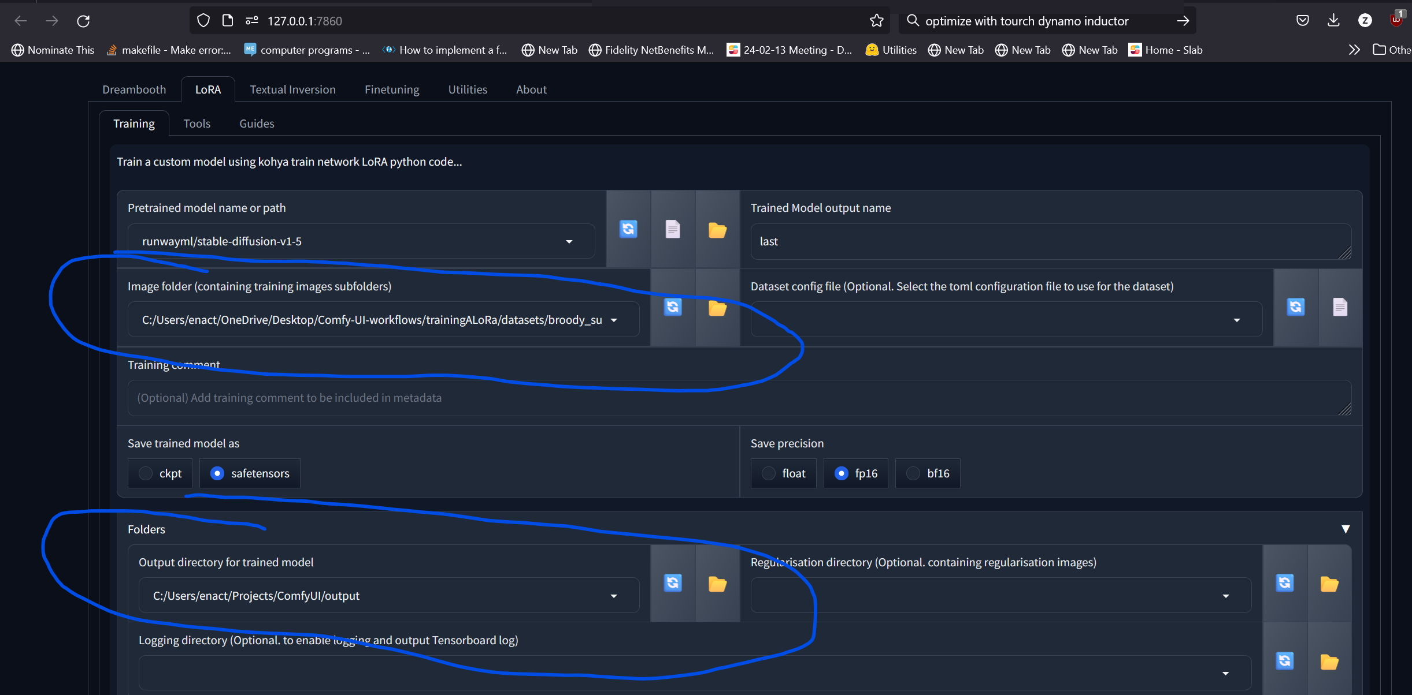

Slide 19
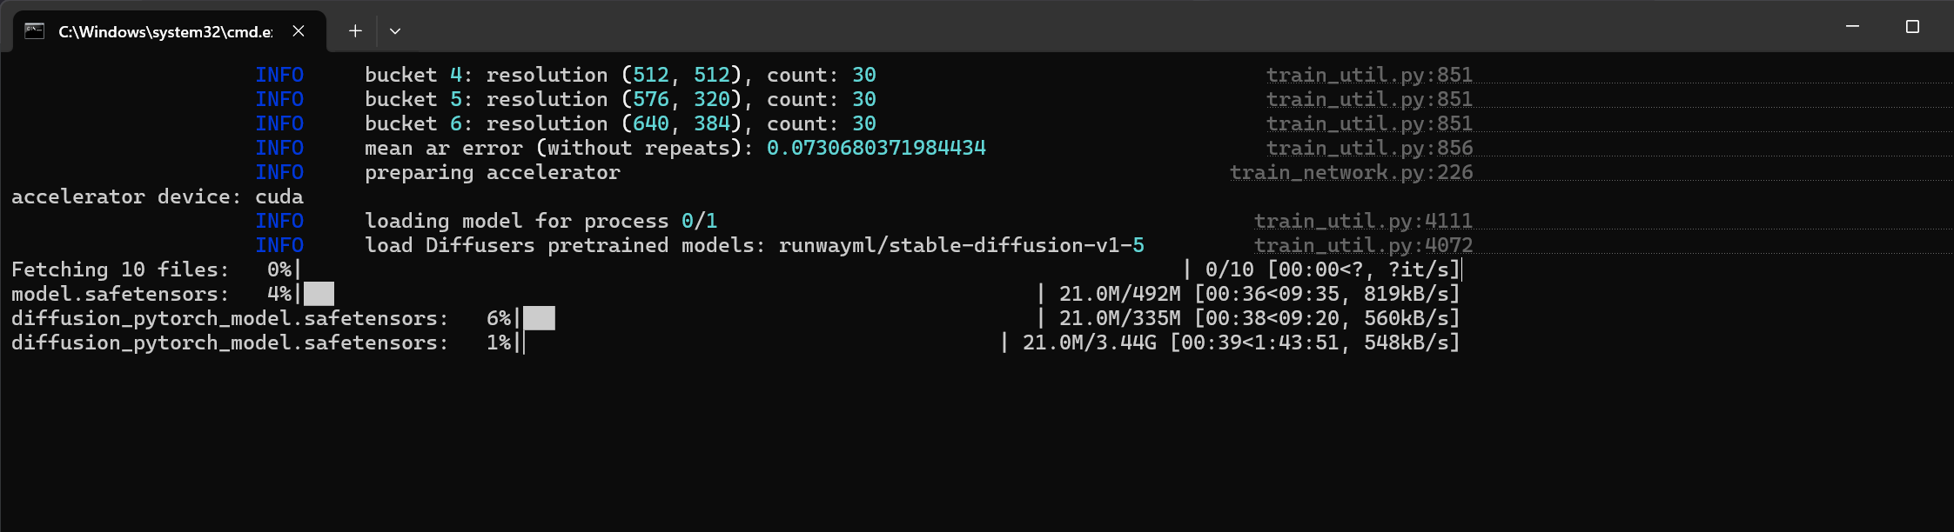
First time runs download background models to a system cache.

Slide 20
Installing Konah_SS for Training LoRA’s
Install the dependencies from the GitHub: https://github.com/bmaltais/kohya_ss
Create an Anaconda environment for the specific version of python needed (yes to all downloads):
conda create --name py3.10 python=3.10.11
conda activate py3.10
Activate a Virtual Environment as well:
python -m venv venv
.\venv\Scripts\activate.bat
Run the installer –
.\setup.bat - select 1 for install. If all other dependencies are installed, this should move along.
If it looks frozen, try doing the pip installs from requiments.txt manually (note there is a Linux and Windows specific requirements file
I installed CuDNN as well
Launch: python kohya_gui.py

Slide 21
Various Notes
Some models (such as AnimateDiff) require XL versions of the models and VAEs – check the references workstreams
Look out for newer paradigms and node types using Stable Cascade - https://huggingface.co/spaces/multimodalart/stable-cascade
Investigate Checkpoints (and LoRA’s etc.) in CivitAI – the documentation for the models often mention certain embeddings to include in the positive or negative prompts to Really get the most out of the model.

Slide 22
Go forth and be creative!

Slide 23
THANK YOU
Matthew Zamora matt@mocomakers.com
I am looking for software full-stack co-founders (Python) for my startup: FluffyNAS.com A hardware/software at-home network accessible storage device

